Slide 1
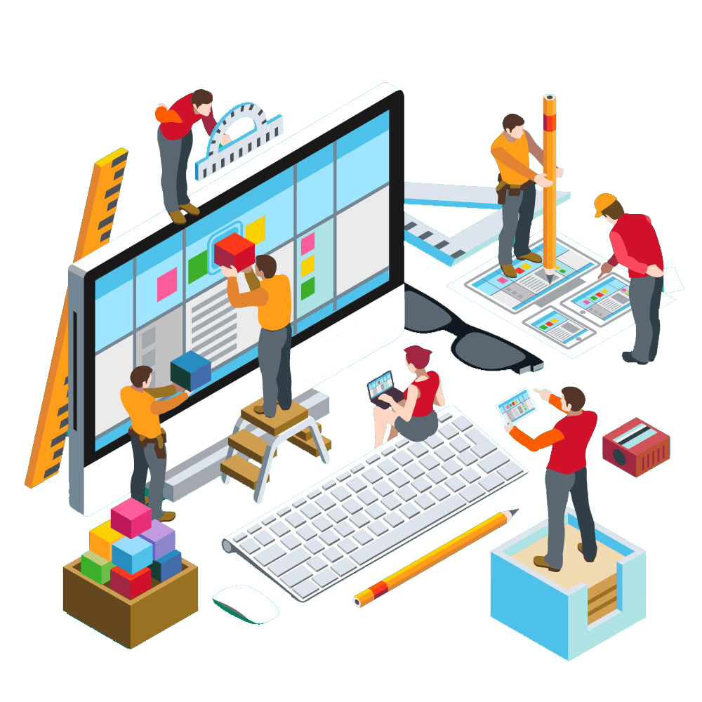
Agile Software Engineering
Tracking and Reporting

Slide 2
Quality
This chapter is focused on tracking and measuring our success and quickly identifying the areas that need attention and improvement.
We review the tools that are used in tracking, such as Kanban task boards, burn charts, information radiators, and progress charts.

Slide 3
Kanban
Kanban is a methodology that we have not focused on because it is fundamentally different from the others that we have discussed.
Most of the Agile methodologies deliver working software in a time-boxed fashion, meaning that the work proceeds in iterations, or sprints.
Conversely, Kanban operates in a “continuous flow” model, meaning that there is no time box for development; tasks are continuously added to the backlog and removed as they are completed.

Slide 4
Kanban
Kanban has three primary characteristics:
Visualize the workflow
  A Kanban board maps the steps of the workflow in columns across a board.
  Items, or tasks, are represented on cards or sticky notes and are tracked as they move through the workflow steps.
Limit work in progress (WIP)
  Assign limits to each column, or workflow step, so that no one group or person can be overloaded with work.
  The WIP limits naturally identify bottlenecks in the process so they can be addressed, in keeping with the Lean principles.
Measure the lead time
  By understanding the workflow and removing the bottlenecks, the teams will discover the time it takes for a task to move from creation to resolution, thus providing the organization with metrics for lead time.

Slide 5
Kanban
How does Kanban compare with Scrum?
Scrum is a great fit for products/ projects with a time-boxed workflow, such as product development efforts, that can progress in a series of sprints or iterations.
On the other hand, Kanban is a better fit for an unpredictable workflow, unplanned work, and development tasks that require deployment in less time than a typical iteration.
For example, Kanban is a great fit for help desk tickets and custom software support where small tickets are continually created and require speedy resolution.

Slide 6
Kanban
Let’s look at Cayman Design for examples. The new calendar option, where customers can buy print calendars with weather-related historical information, is new product development.
It makes sense for that work to progress on a sprint cycle, with new features added in each sprint until the entire product is ready for release.
Our product that is in production, however, may have issues that our current customers need addressed, and we have a support team that works those tickets.

Slide 7
Kanban
One customer may report an issue with the browser Chrome; the support team needs to log that ticket, investigate it, write code to correct the issue, and then push that code to production.
The customer would not want to wait for that story to be groomed, prioritized, estimated, and put into a sprint and then worked on—they need it fixed right away.
This is where Kanban is a great option because it shares all of the Agile elements that make this work so well— collaboration, clear prioritization, small increments of work, fast delivery of working software—and moves it to a continuous workflow.

Slide 8
Kanban Board
Teams often use white boards and sticky notes to create the Kanban board, but any visual tool can be used, from a chalkboard to a large sheet of paper and markers. There are also software programs that create online Kanban boards, which is helpful for distributed teams.
Looking at a specific example, we have five columns on our Kanban board:
“backlog,” “not started,” “in progress,” “testing,” and “completed.”
Because workflow stages can vary based on the nature of the work, the columns will change to match the needs of the particular team.

Slide 9
Kanban Board
Backlog
  The product owner puts all of the requirements (stories) on sticky notes in priority order. The estimated effort of the requirement is also noted. This list could be quite lengthy, depending on the size of the backlog.
Not started
  These stories have been selected by a developer and are therefore assigned, but the development work has yet to begin. This is equivalent to a “pending” queue, or the next items to be worked.
In progress
  These are the requirements that are currently being coded by a developer.
Testing
  This is when the testing is done to ensure that the code is working as intended.
Completed
  The requirements in this column are considered ready to be delivered to a customer.

Slide 10
Work in Progress (WIP) Limit
Kanban allows for limiting the amount of work (stories) in a given stage at any point in time; this limit is commonly referred to as the work in progress (WIP) limit.
WIP limits help organizations to identify where there are bottlenecks in their processes.
One of the key tenets of Agile is increased transparency, and the Kanban WIP limits bring attention and focus to the areas of the business where things are slowing down so we can quickly address and correct the situation.

Slide 11
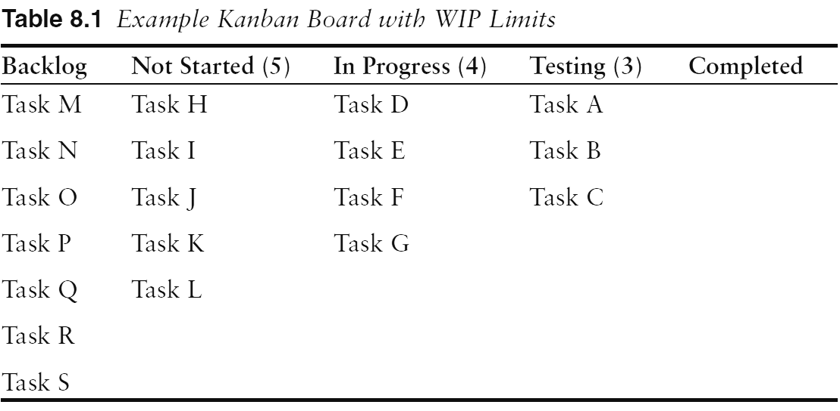
Work in Progress (WIP) Limit
For example, on our Kanban board, we have the following WIP limits:
    Backlog: No limit
    Not started: WIP limit of 5
    In progress: WIP limit of 4
    Testing: WIP limit of 3
    Completed: No limit

Slide 12
Work in Progress (WIP) Limit
By having these limits, we can identify where our bottlenecks are.
In this rudimentary example, all of the WIP limits have been reached, and each person is working diligently on his or her tasks. If the developer finishes task D, he cannot move it into testing because their queue is already full.
He must wait until task A, B, or C is completed in testing and moved to completion before task D can be pulled into the testing queue. To move task D into testing now would violate the testing WIP limit of 3.
Therefore, our developer
who has completed task D
cannot pull task H in from
the “not started” queue,
because adding that task
to the “in progress” queue
would violate the WIP
limit of 4.

Slide 13
Work in Progress (WIP) Limit
There are many reasons why this is valuable and reinforces the values of Agile.
Perhaps the developers are moving very fast and, as an unfortunate result, they are writing buggy code.
Thus, the testing queue is backed up because they cannot get tasks A, B and C to pass testing.
The developers are finishing more tasks but they cannot move them to testing yet—and they cannot pick up any new tasks.
Therefore, the developers can help the testers with their tasks; the testing queue will get cleared, and the developers will understand that the better code they write, the more smoothly the process will go.

Slide 14
Work in Progress (WIP) Limit
The WIP limits also prevent the product owner (or executives) from forcing too much work on the team.
The “not started” queue has a WIP limit of 5, so those represent the stories or tasks that are well defined and prioritized.
Just as Scrum limits the amount of work by allowing the team to commit only to what they can reasonably finish in the duration of a sprint, the WIP limits accomplish the same goal by limiting how much work can be in each queue.

Slide 15
Work in Progress (WIP) Limit
In this example, WIP limits are set by the number of tasks, but as you can imagine, not all tasks are equal; some tasks are much larger or more complex than others, so some teams set their WIP limits by the number of story points as described in Chapter 6, “Grooming and Planning.”
WIP limits could also be based on hours required to complete the task.
Setting and enforcing WIP limits can be challenging for teams, so some teams that are new to Kanban start with the workflow and the Kanban board and add WIP limits later, when they are more comfortable with the process.

Slide 16
Work in Progress (WIP) Limit
The Kanban principles are built into Lean software development.
Lean principles focus on eliminating waste, specifically “muda,” “mura,” and “muri”; an effective Kanban board will address all three.
“Muda” is waste created by an activity in the process that adds no value; value stream mapping.
  When diagramming the workflow to define the columns in Kanban, muda would be evident as a step that is not valuable.
“Mura” is the waste generated by unevenness in operations.
  With the visibility of the Kanban board, we can easily see the work flowing through the system to isolate inefficiencies where work is uneven.

Slide 17
Work in Progress (WIP) Limit
Finally, there is “muri,” which is the overburdening of people or equipment with more work than they can reasonably manage.
  The WIP limits in Kanban detect muri by clearly identifying bottlenecks in the process where more work is being added than can effectively be delivered.
Kanban is a wonderful alternative for teams who want to embrace all of the values and principles of Agile but whose work is unpredictable and difficult to plan.
In many organizations, both Scrum and Kanban are utilized, depending on the makeup of the work.

Slide 18
Tracking
Regardless of the particular methodology being used, tracking progress is critical to Agile.
Increased transparency and the desire to eliminate surprises make tracking essential to effectively managing an Agile project.
We explore several tracking mechanisms and philosophies in detail.

Slide 19
Tracking - XP
XP takes tracking so seriously that one of their roles is that of a tracker.
The tracker talks to the developers daily and asks two questions—how many ideal days have they worked on a task, and how many ideal days do they have remaining.
The ideal days or ideal time is the amount of time a task would take under ideal circumstances, with no interruptions, phone calls, meetings, etc.
The tracker should talk to each developer about the task.
This reinforces the importance of face-to-face communication so the tracker can ensure that he or she obtaining accurate and realistic responses from the developer.
Scrum addresses this in a similar fashion, through the use of the daily stand-up meeting

Slide 20
Tracking – Burn Charts
Burn charts are a mechanism to be transparent about the progress of a release or iteration so the team can decide if they need to alter their approach to the work in order to honor their commitments.
By being able to easily see their actual progress charted against the planned progress, they have actionable data to inform their decisions.

Slide 21
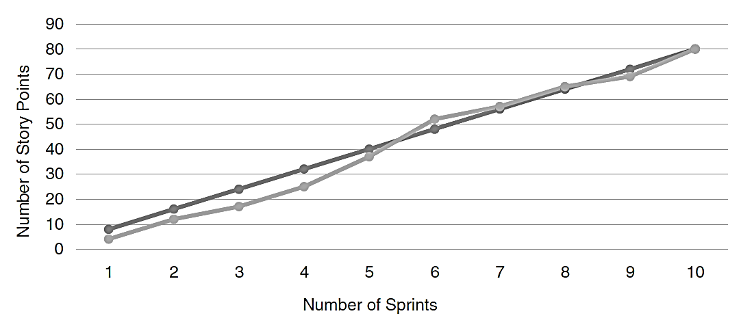
Tracking – Burn Charts
Burn-Up Charts
Burn-up charts are a way to depict progress toward a product’s release goal.
Typically, time is on the X axis, either in sprints, months, or quarters, and the Y axis represents the release at completion.
The Y axis
can be
either story
points or
feature
descriptions.

Slide 22
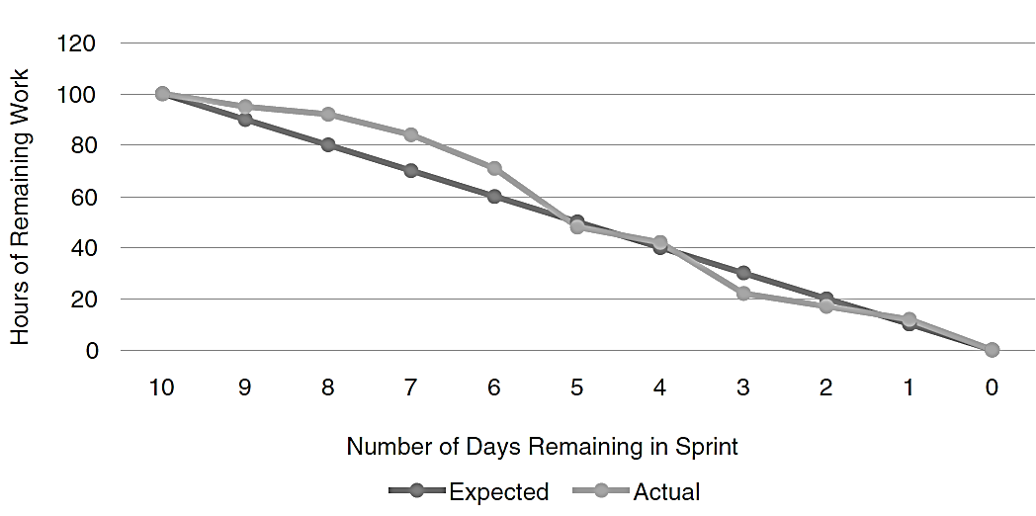
Tracking – Burn Charts
Burn-Down Charts
Burn-down charts serve a different purpose: These are the daily status checks for the team relative to where they expected to be at a particular point in time.
This is a critical tracking element within a sprint or iteration to ensure that any necessary course correction is identified and addressed as early as possible.
The team can see
the total number
of hours allocated
to the sprint and
track their actual
progress against the target.

Slide 23
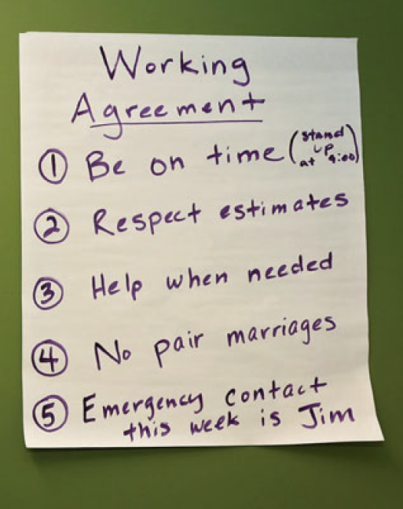
Information Radiators
Information radiators are anything posted in the team members’ physical space that they will walk by or see on a regular basis.
The idea is that the information radiates into the team’s subconscious because they encounter the information regularly.
Radiators work in much the same way
as advertisements on billboards along
the freeway.
They encourage you to think about
ideas because they are presented to
you regularly.

Slide 24
Information Radiators
For some Agile teams, the information radiator might be some best practices posted on a white board, such as “We will not write new code until all defects are closed.”
Other teams may post the daily status in a common area so the team members know what is going on with the project and maintain a sense of urgency.
Some teams may even use information radiators to promote a positive culture and post birthdays or promotions for everyone to see.
Regardless of how a team decides to use information radiators, they are a helpful tool to promote team communication.

Slide 25
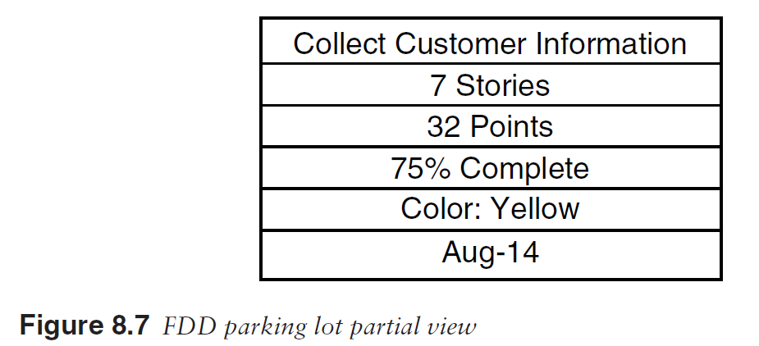
Tracking – FDD – Parking Lots
FDD incorporates an excellent way to track progress on larger projects where many activities are contributing to a cohesive whole.
For our Cayman Design project, we want to create and sell weather-related calendars to customers; this is a large departure from the other features in our weather app because we have to consider inventory, shipping, and payment details.

Slide 26
Tracking – FDD – Parking Lots
FDD incorporates an excellent way to track progress on larger projects where many activities are contributing to a cohesive whole.
For our Cayman Design project, we want to create and sell weather-related calendars to customers; this is a large departure from the other features in our weather app because we have to consider inventory, shipping, and payment details.
“Collect Customer Information” consists of seven stories
totaling 32 points.
At this moment, we are 75% complete,
and the feature is needed by
August 2014.
The color on the story can indicate
its health, this particular story
being yellow, meaning it is in jeopardy.

Slide 27
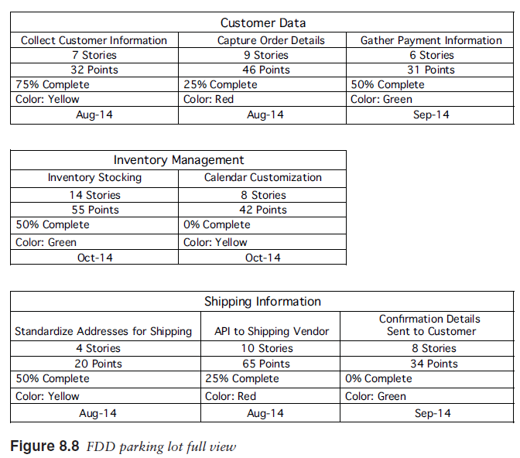
Tracking – FDD – Parking Lots

Slide 28
Tracking – FDD – Parking Lots
From this parking lot view, you can get an immediate sense for the project health, even though we are looking at a total of 66 stories and 325 points.
You can add teams/owners to each parking lot and define a more detailed color scheme as needed for your particular project.
FDD’s model-driven approach allows it to scale to support large, complex projects

Slide 29
Meetings or Ceremonies
Because the teams are working hard during the sprint or iteration to design, code, and test the requirements, we need a mechanism to keep track of their progress and make sure everything is working well on the teams.
Similar to how the XP tracker asks each developer how things are going, Scrum, Lean, and DSDM all recommend a daily stand-up meeting, sometimes called the daily Scrum.

Slide 30
Meetings or Ceremonies
Daily Stand-Up Meeting
Development teams use the daily stand-up meeting to do a quick status check and prepare the team for the day.
These meetings usually take less than 15 minutes and provide an opportunity to understand the team’s progress in the iteration.
Each team member answers three key questions during the daily stand-up meeting:

Slide 31
Meetings or Ceremonies
Daily Stand-Up Meeting
What did I do yesterday?
  This is an opportunity for a developer to share what tasks were closed yesterday or if something was more difficult than expected or will require more time.
What am I planning to do today?
  This information helps the team know the developer’s area of focus for the day and also if he or she will be unavailable for some portion of time because of meetings or personal considerations.
  By understanding what a teammate is working on, the other team members can align their work, if necessary.
Is there anything blocking my progress?
  This could be anything that is preventing advancement, from a technical issue to the lack of a test environment to a clarification question with the product owner.
  The key is to share challenges to keep things moving forward in the iteration.

Slide 32
Meetings or Ceremonies
Daily Stand-Up Meeting
Within Agile, the team succeeds or fails together.
To ensure that commitments are kept, the team needs to band together to deliver on all tasks.
The daily stand-up meeting provides a forum for teammates to calibrate on the work remaining and support each other to success.

Slide 33
Meetings or Ceremonies
Sprint Review or Demo
A Sprint review, or Sprint demo, is a meeting hosted by the team that is open to a wide audience including extended team members, stakeholders, and potentially even external customers.
The sprint review provides the opportunity to showcase the working software to inform and educate the organization on what has been completed and to gather feedback to ensure that the product is delivering on expectations.
The session is not intended to be a large, professional meeting with a lengthy presentation. In fact, most teams limit the “prep” time for the demo to two hours or less; we want the teams to spend their time writing great code, not producing pretty PowerPoint slides.

Slide 34
Meetings or Ceremonies
Sprint Review or Demo
The person who leads the discussion varies by team and may even vary by Sprint review.
Often the product owner will describe the user stories that were tackled during the sprint, and the Scrum master will demonstrate the working software.
On other teams, the product owner runs the entire meeting, because having a nontechnical person work through the software demonstrates its usability.
On still other teams, the developers do the demonstration because they feel a great sense of ownership for the value that they have created with the software.

Slide 35
Meetings or Ceremonies
Sprint Review or Demo
If the feedback is particularly negative, the team will need to evaluate whether they should make the new feature publicly available.
Positive feedback validates that the new feature is ready for deployment.
If the stakeholders offer opportunities for improvement, those can be documented as potential new requirements.

Slide 36
Meetings or Ceremonies
Retrospectives
Retrospectives are an important part of Agile software development as a forum for open communication among team members and as a tool for continual improvement.
The Agile Manifesto emphasizes team retrospectives in this principle:
“At regular intervals, the team reflects on how to become more effective, then tunes and adjusts its behavior accordingly.”
A retrospective is a team meeting at the end of an iteration where the team has the opportunity to inspect and adapt their teamwork

Slide 37
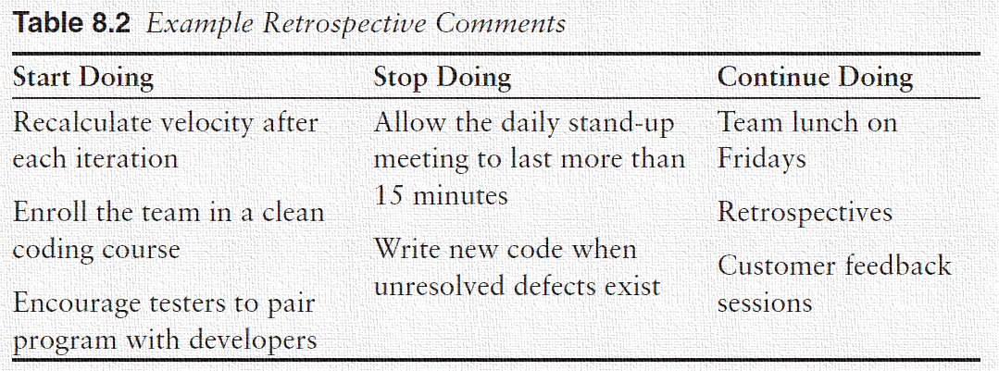
Meetings or Ceremonies
Retrospectives
One method for facilitating the discussion is to pass out note cards and ask participants to jot down their observations into categories; the categories could be “stop doing,” “start doing,” and “continue,”.
Retrospectives are an important vehicle for the team to continuously grow together as an entity, which will make their work environment more productive and more enjoyable.

Slide 38
Measuring Success in Agile
How do you know if an Agile project is successful?
This topic has sparked a great deal of debate, because some Waterfall metrics drive the wrong behavior and thus are inappropriate.
Rally Software has developed a nice framework for measuring performance, in which they suggest four categories of measurement.
Do it fast
Do it right
Do it on time
Keep doing it

Slide 39
Measuring Success in Agile
These parameters align well with the core values and principles of Agile.
In the “do it fast” category, we can measure the teams’ productivity and their responsiveness.
In the “do it right” category, we are measuring quality and customer satisfaction.
When we “do it on time,” we demonstrate a predictable cadence for when working software is delivered.
Under “keep doing it,” we want to measure employee satisfaction, which is a critical component of sustainability as referenced in the Agile principles.

Slide 40
Measuring Success in Agile
Truly, the absolute best measure of success for Agile teams is customer satisfaction.
If your organization is delivering high-quality software that meets the needs of the users and is delivered quickly and predictably, then your customer satisfaction scores should be steadily (or dramatically) improving.

